Slide 1
Algorithm Analysis and Design Growth of Functions Week 2 Lecture – 4,5, and 6

Slide 2
Overview
A way to describe behavior of functions in the limit. We’re studying asymptotic efficiency.
• Describe growth of functions.
• Focus on what’s important by abstracting away low-order terms and constant factors.
• How we indicate running times of algorithms.
• A way to compare “sizes” of functions:

Slide 3
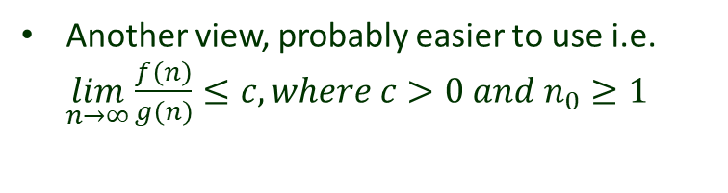
Asymptotic notation (Big Oh )

Slide 4
Asymptotic notation (Big Oh )

Slide 5

Asymptotic notation (Big Oh )
Example 1
$$Prove that f\left(n\right)=2n+3 ∈ O(n)$$

Slide 6
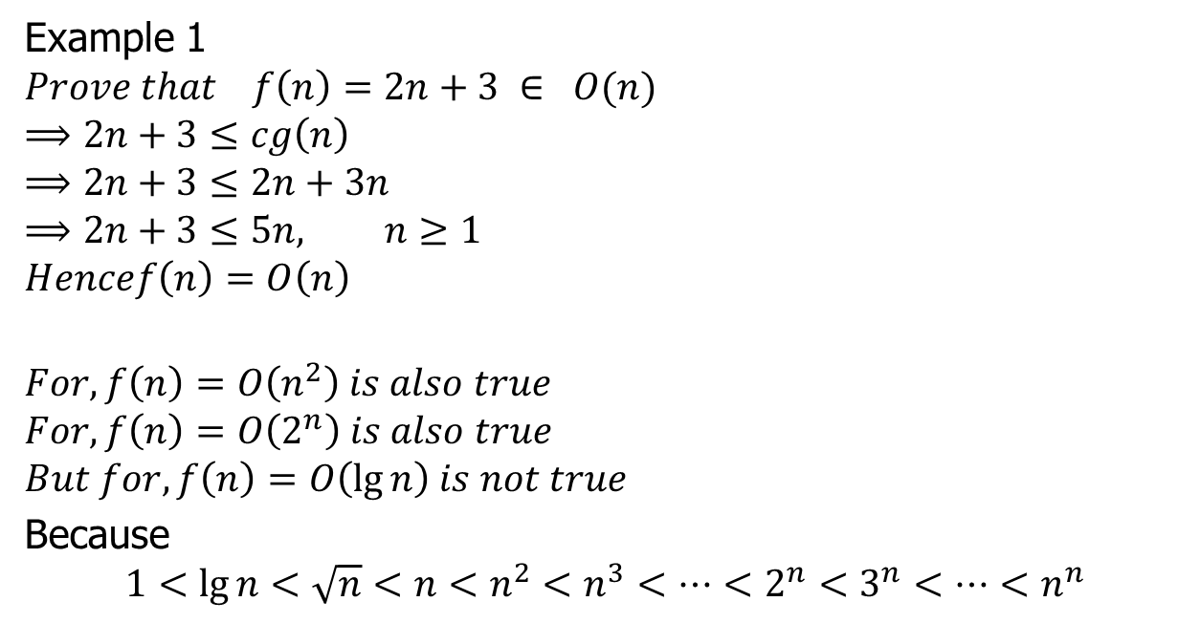
Asymptotic notation (Big Oh )
Example 1
$$Prove that f\left(n\right)=2n+3 ∈ O(n)$$
$$⟹2n+3≤cg\left(n\right)$$
$$⟹2n+3≤2n+3n$$
$$⟹2n+3≤5n, n≥1$$
$$Hencef\left(n\right)=O\left(n\right)$$
$$For, f\left(n\right)=O\left(n^{2}\right) is also true$$
$$For, f\left(n\right)=O\left(2^{n}\right) is also true$$
$$But for, f\left(n\right)=O\left(\lg{n}\right) is not true$$
Because
$$1<\lg{n}<\sqrt{n}<n<n^{2}<n^{3}<…<2^{n}<3^{n}<…<n^{n}$$

Slide 7

Asymptotic notation (Big Oh )
Example 2
$$Prove that f\left(n\right)=2n^{2}+3n+4 ∈ O\left(n^{2}\right)$$

Slide 8

Asymptotic notation (Big Oh )
Example 2
$$Prove that f\left(n\right)=2n^{2}+3n+4 ∈ O\left(n^{2}\right)$$
$$⟹2n^{2}+3n+4≤2n^{2}+3n^{2}+4n^{2}$$
$$⟹2n^{2}+3n+4≤9n^{2} , where c=9 and n≥1$$
$$Hencef\left(n\right)=O\left(n^{2}\right)$$

Slide 9

Asymptotic notation (Big Oh )
Example 3
$If f\left(n\right)=2^{n+1} and g\left(n\right)= 2^{n} the prove that f\left(n\right)∈ Ο(g\left(n\right))$

Slide 10
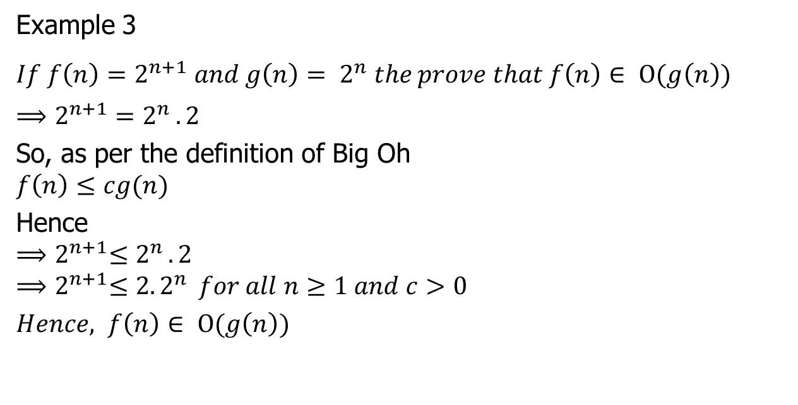
Asymptotic notation (Big Oh )
Example 3
$If f\left(n\right)=2^{n+1} and g\left(n\right)= 2^{n} the prove that f\left(n\right)∈ Ο(g\left(n\right))$
$$⟹2^{n+1}=2^{n }.2$$
So, as per the definition of Big Oh
$$f\left(n\right)≤cg(n)$$
Hence
$${⟹2}^{n+1}≤2^{n }.2$$
$${⟹2}^{n+1}≤{2. 2}^{n } for all n≥1 and c>0$$
$Hence, f\left(n\right)∈ Ο(g\left(n\right))$

Slide 11
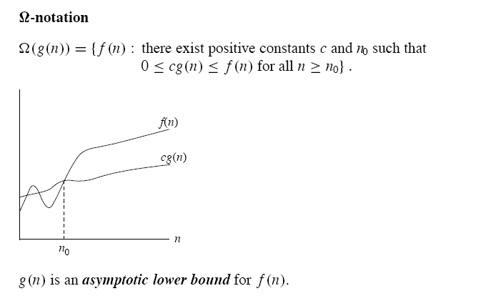
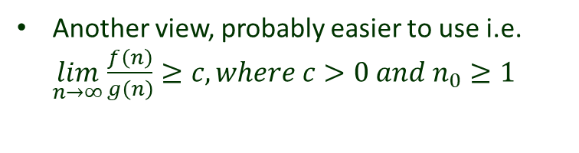
Asymptotic notation (Omega )

Slide 12
Asymptotic notation ( Omega )

Slide 13

Asymptotic notation ( Omega )
Example 4
$$Prove that f\left(n\right)=2n^{2}+3n+4 ∈ Ω\left(n^{2}\right)$$

Slide 14

Asymptotic notation (Omega )
Example 4
$$Prove that f\left(n\right)=2n^{2}+3n+4 ∈ Ω\left(n^{2}\right)$$
$$⟹2n^{2}+3n+4≥1∗n^{2}$$
$$Hence f\left(n\right)=Ω\left(n^{2}\right) where c=1 and n≥1$$

Slide 15

Asymptotic notation ( Omega )
Example 5
$$If f\left(n\right)=3n+2, g\left(n\right)=n^{2} show that f\left(n\right) ∉Ω(g\left(n\right))$$

Slide 16
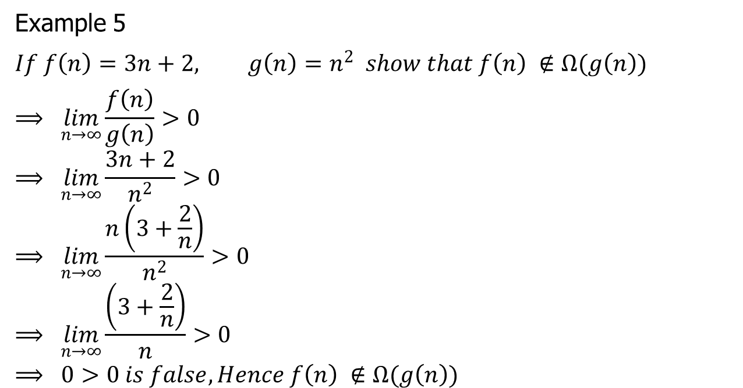
Asymptotic notation ( Omega )
Example 5
$$If f\left(n\right)=3n+2, g\left(n\right)=n^{2} show that f\left(n\right) ∉Ω(g\left(n\right))$$
$$⟹ \lim_{n→∞}\frac{f\left(n\right)}{g\left(n\right)}>0$$
$$⟹ \lim_{n→∞}\frac{3n+2}{n^{2}}>0$$
$$⟹ \lim_{n→∞}\frac{n\left(3+\frac{2}{n}\right)}{n^{2}}>0$$
$$⟹ \lim_{n→∞}\frac{\left(3+\frac{2}{n}\right)}{n}>0$$
$$⟹ 0>0 is false, Hence f\left(n\right) ∉Ω(g\left(n\right))$$

Slide 17

Asymptotic notation ( Omega )
Example 6
$$If f\left(n\right)=2^{n}+n^{2} and g\left(n\right)=2^{n} show that f\left(n\right) ∈Ω(g\left(n\right))$$

Slide 18

Asymptotic notation (Omega )
Example 6
$$If f\left(n\right)=2^{n}+n^{2} and g\left(n\right)=2^{n} show that f\left(n\right) ∈Ω(g\left(n\right))$$
$$⟹ 2^{n}+n^{2}> 2^{n} for all n≥1 and c=1$$
$$Hence, f\left(n\right) ∈Ω\left(g\left(n\right)\right)is true$$

Slide 19
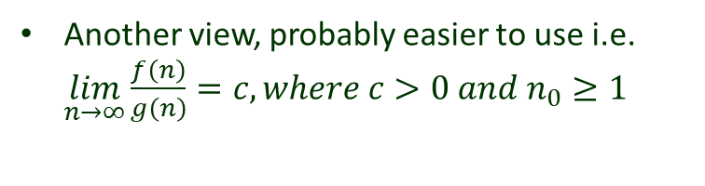
Asymptotic notation (Theta)

Slide 20

Asymptotic notation (Theta)
Example 7
$$Show that f\left(n\right)=10n^{3}+5n^{2}+17∈Θ\left(n^{3}\right)$$

Slide 21
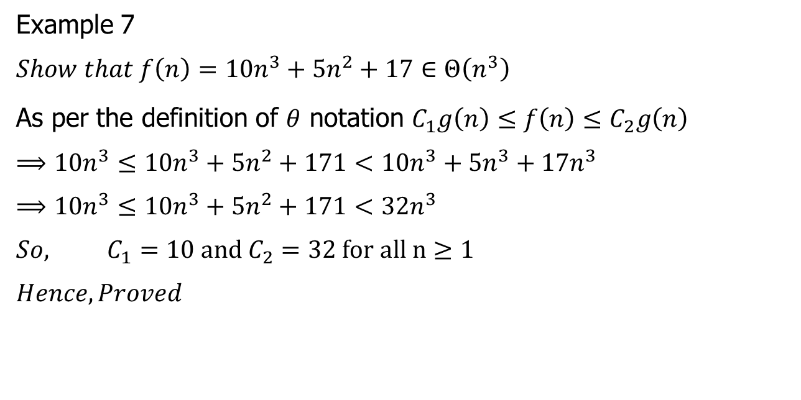
Asymptotic notation (Theta)
Example 7
$$Show that f\left(n\right)=10n^{3}+5n^{2}+17∈Θ\left(n^{3}\right)$$
As per the definition of $θ$ notation $C_{1}g\left(n\right)≤f\left(n\right)≤C_{2}g\left(n\right)$
$$⟹10n^{3}≤10n^{3}+5n^{2}+171<10n^{3}+5n^{3}+17n^{3}$$
$$⟹10n^{3}≤10n^{3}+5n^{2}+171<32n^{3}$$
$$So, C_{1}=10 and C_{2}=32 for all n≥1$$
$$Hence, Proved$$

Slide 22

Asymptotic notation (Theta)
Example 8
$$Show that f\left(n\right)={(n+a)}^{b}∈Θ\left(n^{b}\right)$$

Slide 23
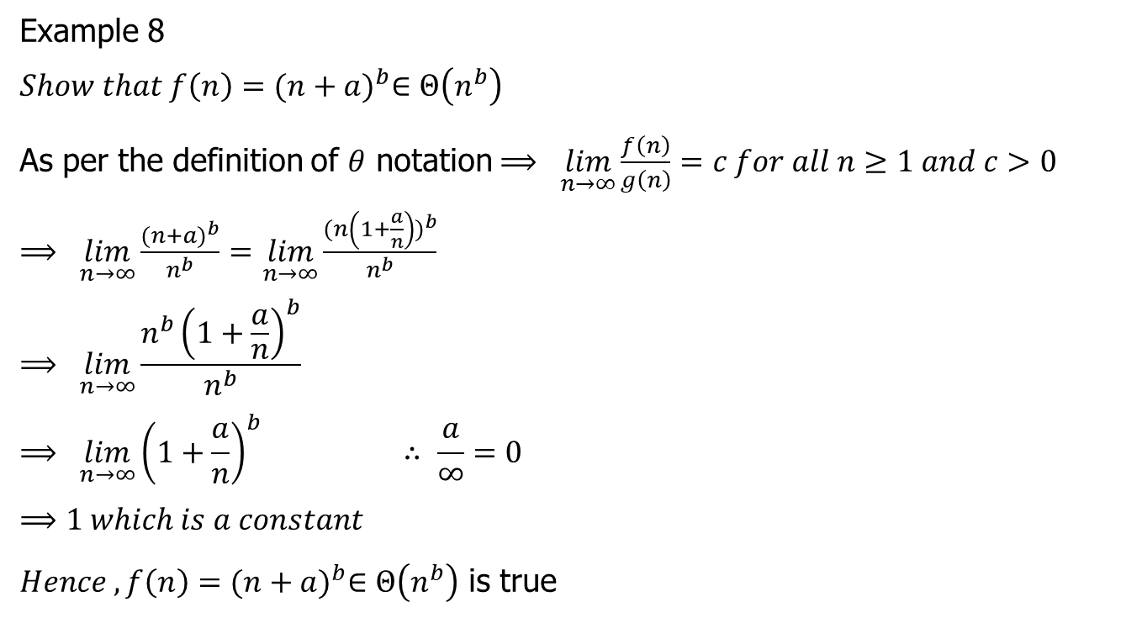
Asymptotic notation (Theta)
Example 8
$$Show that f\left(n\right)={(n+a)}^{b}∈Θ\left(n^{b}\right)$$
As per the definition of $θ$ notation $⟹ \lim_{n→∞}\frac{f\left(n\right)}{g\left(n\right)}=c for all n≥1 and c>0$
$⟹ \lim_{n→∞}\frac{{(n+a)}^{b}}{n^{b}}=$ $\lim_{n→∞}\frac{{(n\left(1+\frac{a}{n}\right))}^{b}}{n^{b}}$
$$⟹ \lim_{n→∞}\frac{{n^{b}\left(1+\frac{a}{n}\right)}^{b}}{n^{b}}$$
$$⟹ \lim_{n→∞}{\left(1+\frac{a}{n}\right)}^{b} ∴ \frac{a}{∞}=0$$
$$⟹1 which is a constant$$
$Hence , f\left(n\right)={(n+a)}^{b}∈Θ\left(n^{b}\right)$ is true

Slide 24
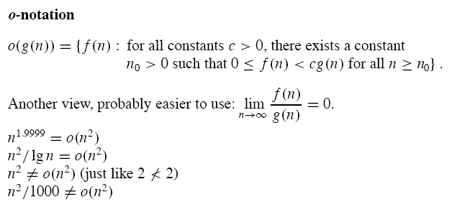
Asymptotic notation (Little Oh )

Slide 25

Asymptotic notation (Little Oh )
Example 9
$$If f\left(n\right)=2n, g\left(n\right)= n^{2} Prove that f\left(n\right)≠ ο(g\left(n\right))$$

Slide 26
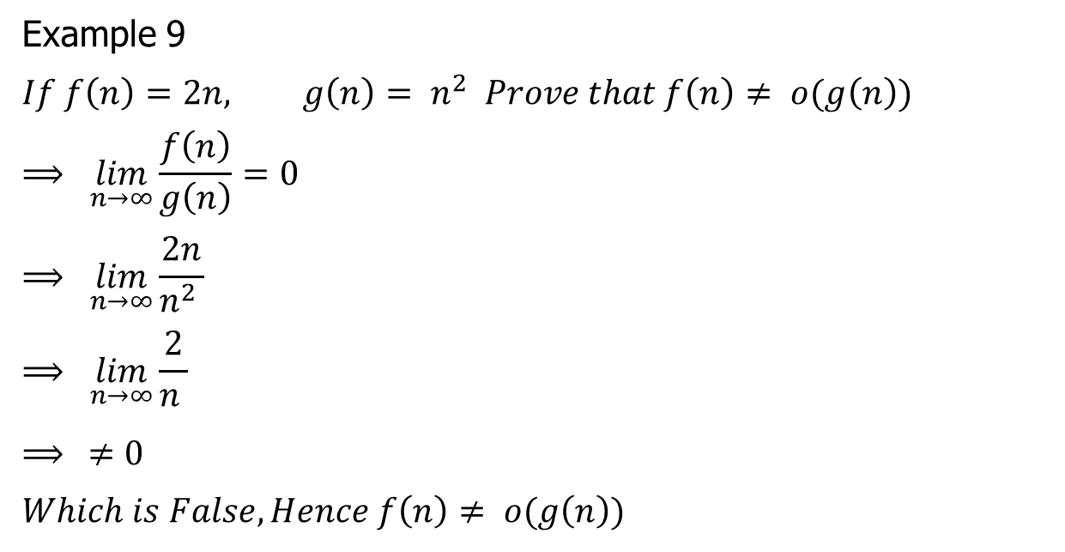
Asymptotic notation (Little Oh )
Example 9
$$If f\left(n\right)=2n, g\left(n\right)= n^{2} Prove that f\left(n\right)≠ ο(g\left(n\right))$$
$$⟹ \lim_{n→∞}\frac{f\left(n\right)}{g\left(n\right)}=0$$
$$⟹ \lim_{n→∞}\frac{2n}{n^{2} }$$
$$⟹ \lim_{n→∞}\frac{2}{n }$$
$⟹ ≠0$
$$Which is False, Hence f\left(n\right)≠ ο(g\left(n\right))$$

Slide 27

Asymptotic notation (Little Oh )
Example 10
$$If f\left(n\right)=2n^{2}, g\left(n\right)= n^{2} Prove that f\left(n\right)= ο(g\left(n\right))$$

Slide 28
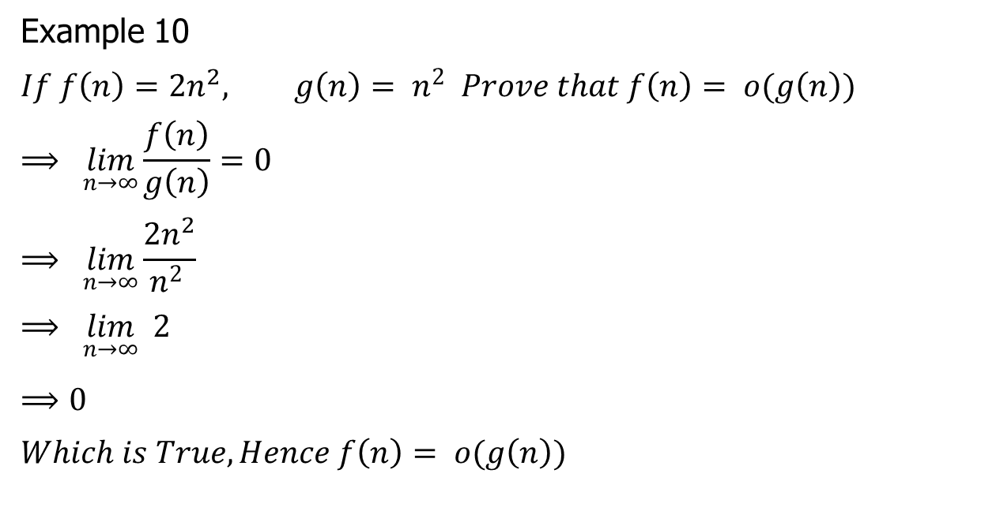
Asymptotic notation (Little Oh )
Example 10
$$If f\left(n\right)=2n^{2}, g\left(n\right)= n^{2} Prove that f\left(n\right)= ο(g\left(n\right))$$
$$⟹ \lim_{n→∞}\frac{f\left(n\right)}{g\left(n\right)}=0$$
$$⟹ \lim_{n→∞}\frac{2n^{2}}{n^{2} }$$
$$⟹ \lim_{n→∞} 2$$
$⟹0$
$$Which is True, Hence f\left(n\right)= ο(g\left(n\right))$$

Slide 29
Asymptotic notation (Little omega )

Slide 30

Asymptotic notation (Little omega )
Example 11
$$If f\left(n\right)=2n^{2}+16 and g\left(n\right)=n^{2} show that f\left(n\right)≠ω\left(g\left(n\right)\right)$$

Slide 31
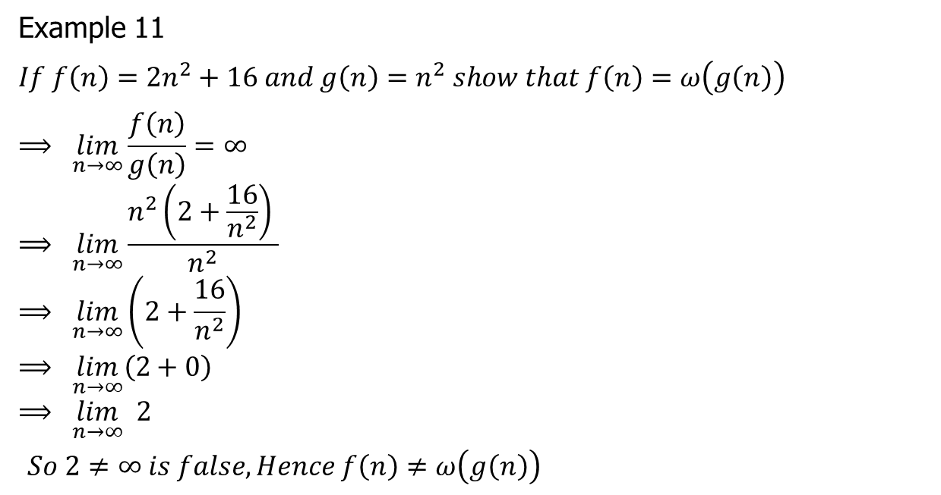
Asymptotic notation (Little omega )
Example 11
$$If f\left(n\right)=2n^{2}+16 and g\left(n\right)=n^{2} show that f\left(n\right)=ω\left(g\left(n\right)\right)$$
$$⟹ \lim_{n→∞}\frac{f\left(n\right)}{g\left(n\right)}=∞$$
$$⟹ \lim_{n→∞}\frac{n^{2}\left(2+\frac{16}{n^{2}}\right) }{n^{2}}$$
$$⟹ \lim_{n→∞}\left(2+\frac{16}{n^{2}}\right)$$
$$⟹ \lim_{n→∞}\left(2+0\right)$$
$$⟹ \lim_{n→∞} 2$$
$So 2≠∞ is false, Hence f\left(n\right)≠ω\left(g\left(n\right)\right)$

Slide 32

Asymptotic notation (Little Oh omega )
Example 12
$$If f\left(n\right)=n^{2} and g\left(n\right)=\log{n}show that f\left(n\right)∈ω\left(g\left(n\right)\right)$$

Slide 33
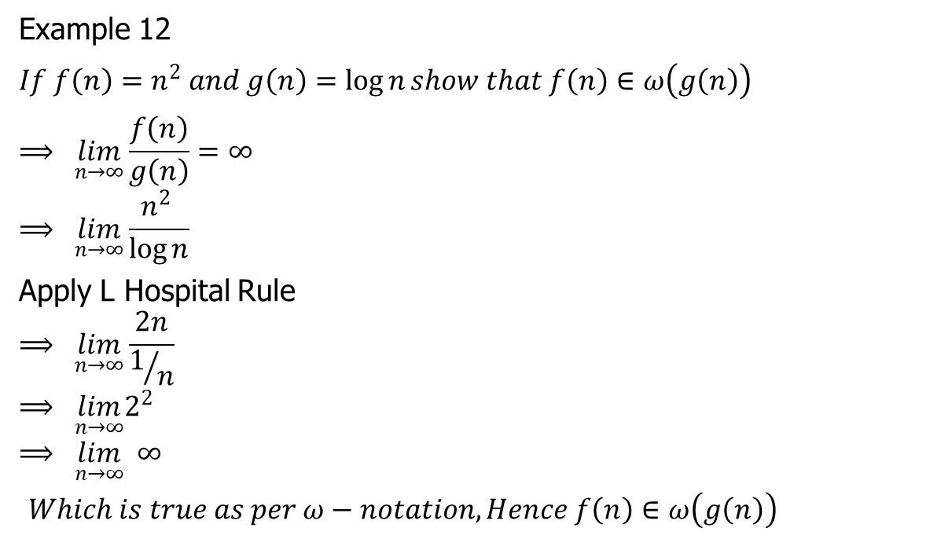
Asymptotic notation (Little Oh omega )
Example 12
$$If f\left(n\right)=n^{2} and g\left(n\right)=\log{n}show that f\left(n\right)∈ω\left(g\left(n\right)\right)$$
$$⟹ \lim_{n→∞}\frac{f\left(n\right)}{g\left(n\right)}=∞$$
$$⟹ \lim_{n→∞}\frac{n^{2} }{\log{n}}$$
Apply L Hospital Rule
$$⟹ \lim_{n→∞}\frac{2n}{1/n}$$
$$⟹ \lim_{n→∞}2^{2}$$
$$⟹ \lim_{n→∞} ∞$$
$Which is true as per ω−notation, Hence f\left(n\right)∈ω\left(g\left(n\right)\right)$

Slide 34
Comparisons of functions

Slide 36
Standard notations and common functions

Slide 39
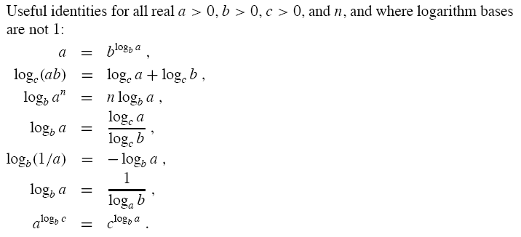

Slide 41

Thank U

